Slide 1
Record cleaning reprise

Slide 2
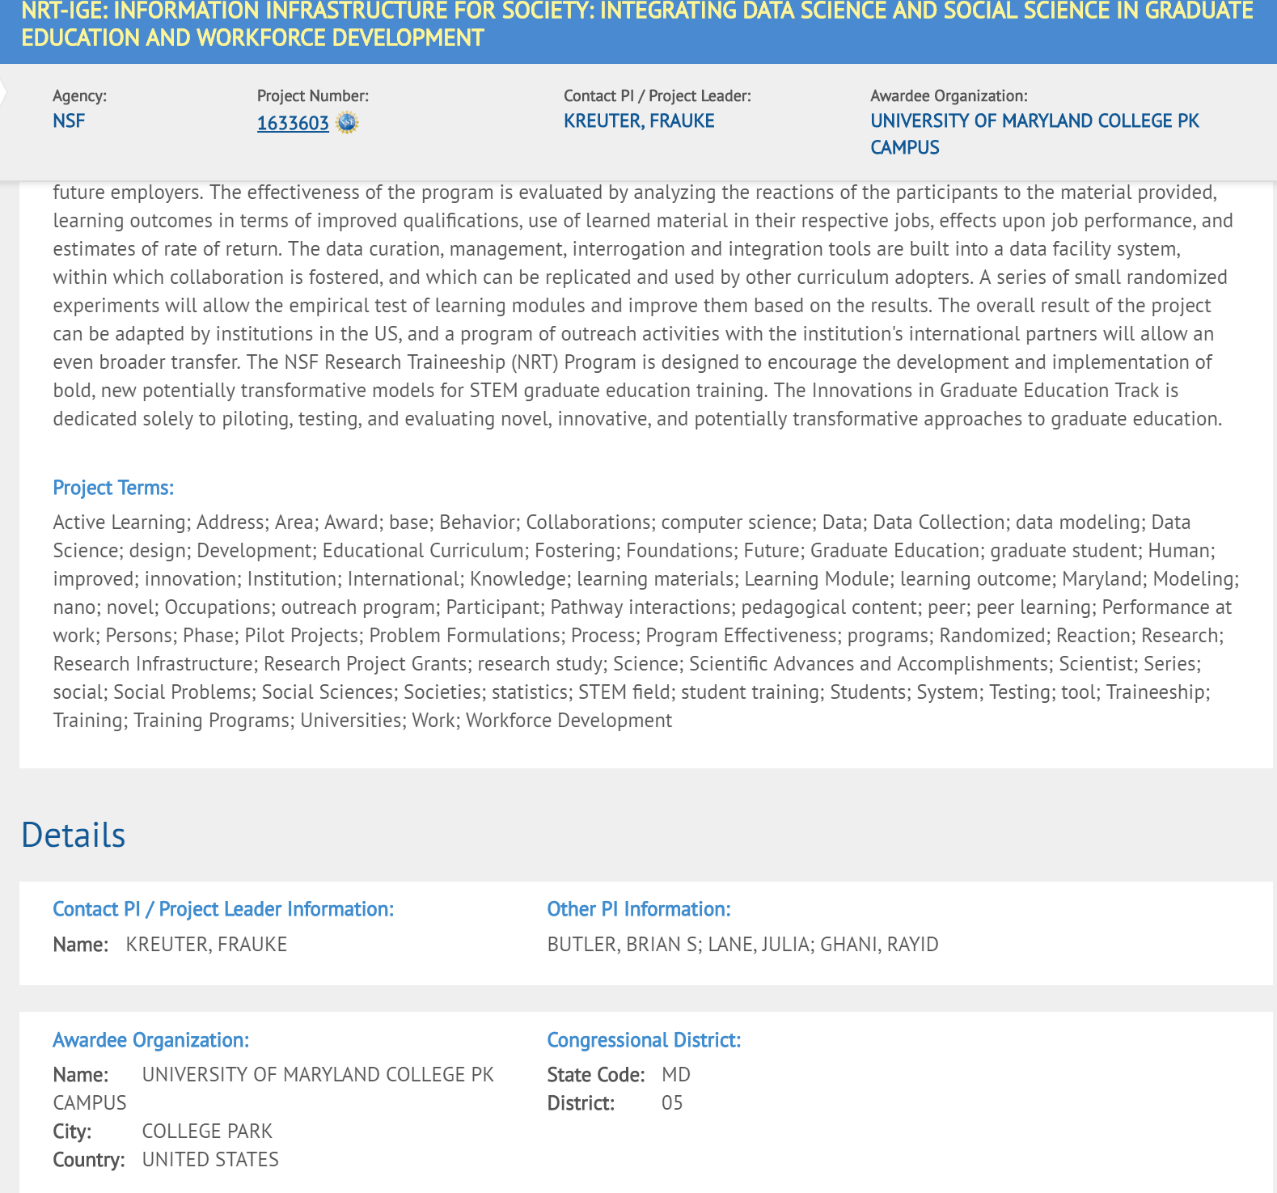
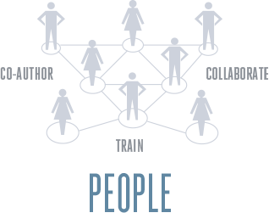

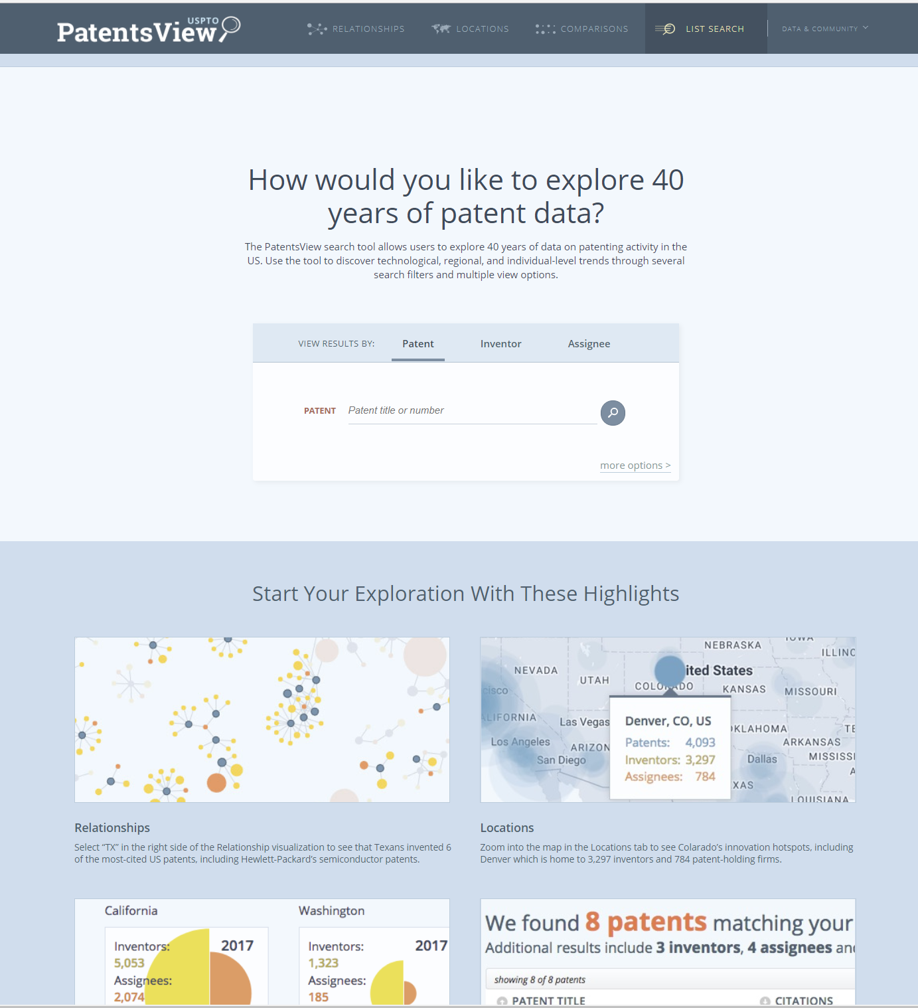

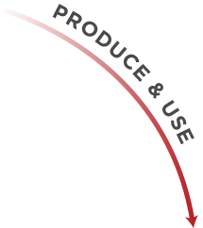





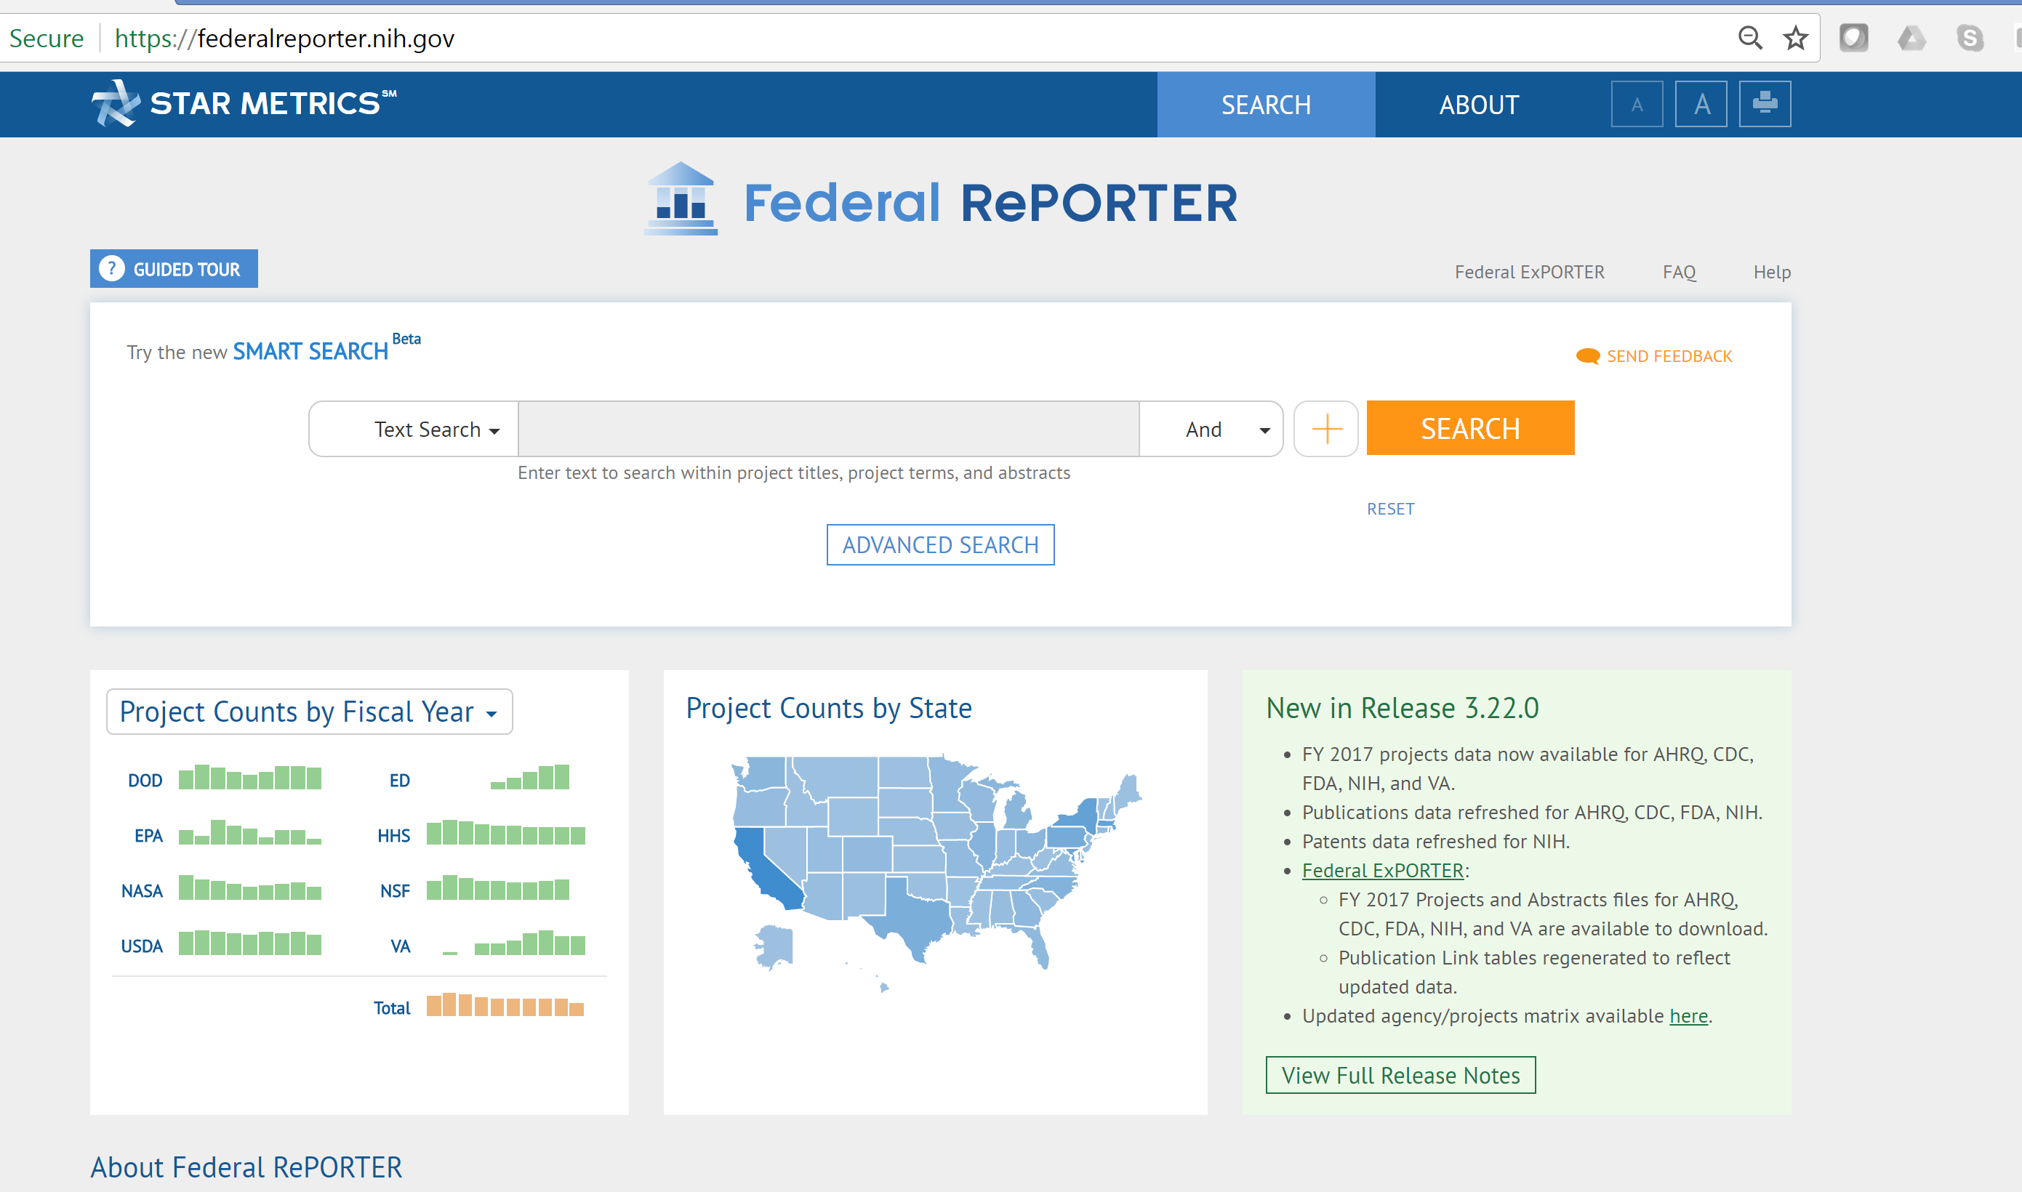
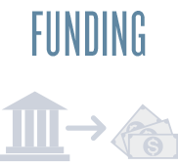
More detail on the problem

Slide 3
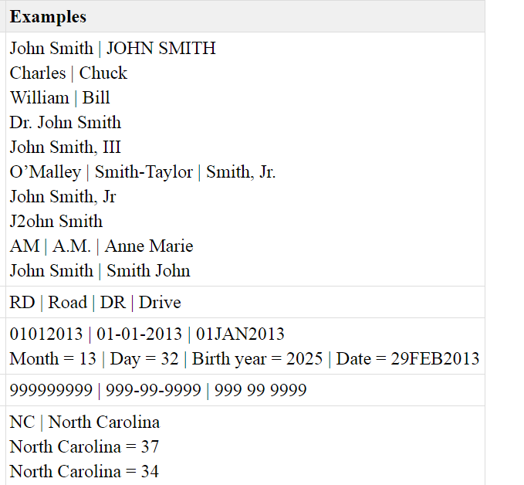
Issues to consider
Lack of unique identifiers
Dirty data
typographical errors
variations
missing and out-of-date values
different coding schemes (i.e. dates)
Dusetzina SB, Tyree S, Meyer AM, et al. (2014) Linking Data for Health Services Research: A Framework and Instructional Guide
Rockville (MD): Agency for Healthcare Research and Quality (US); 2014 Sep. https://www.ncbi.nlm.nih.gov/books/NBK253312/

Slide 4
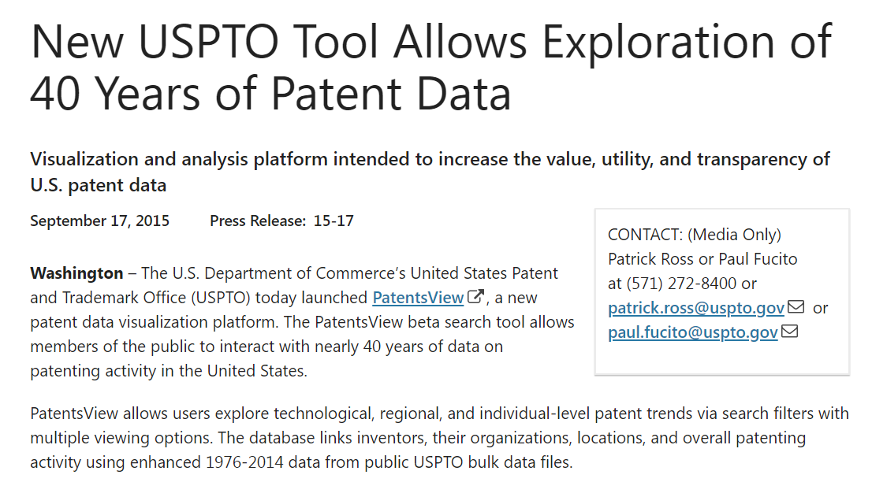

Slide 5
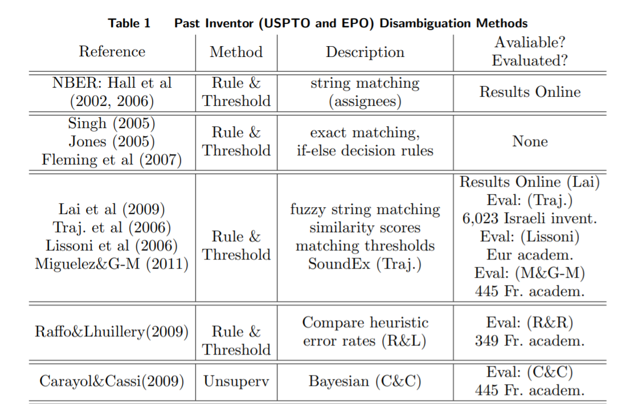
Ventura, Samuel and Nugent, Rebecca and Fuchs, Erica Renee, Seeing the Non-Stars: (Some) Sources of Bias in Past Disambiguation Approaches and a New Public Tool Leveraging Labeled Records (January 27, 2015). Research Policy, Forthcoming. Available at SSRN: https://ssrn.com/abstract=2079330 or http://dx.doi.org/10.2139/ssrn.2079330

Slide 6
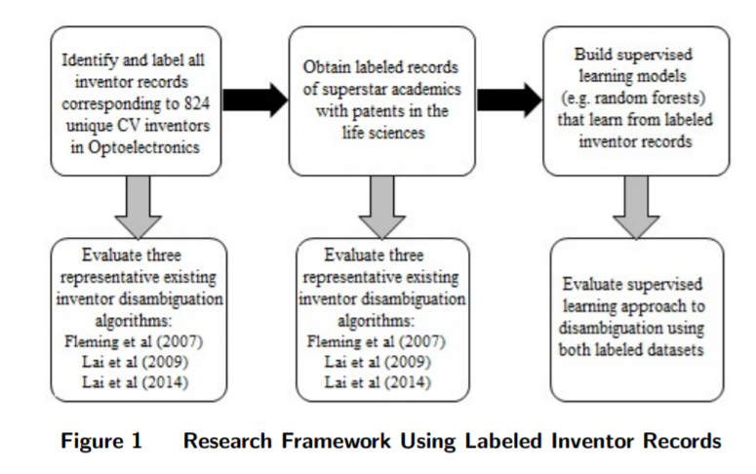
Ventura, Samuel and Nugent, Rebecca and Fuchs, Erica Renee, Seeing the Non-Stars: (Some) Sources of Bias in Past Disambiguation Approaches and a New Public Tool Leveraging Labeled Records (January 27, 2015). Research Policy, Forthcoming. Available at SSRN: https://ssrn.com/abstract=2079330 or http://dx.doi.org/10.2139/ssrn.2079330

Slide 7
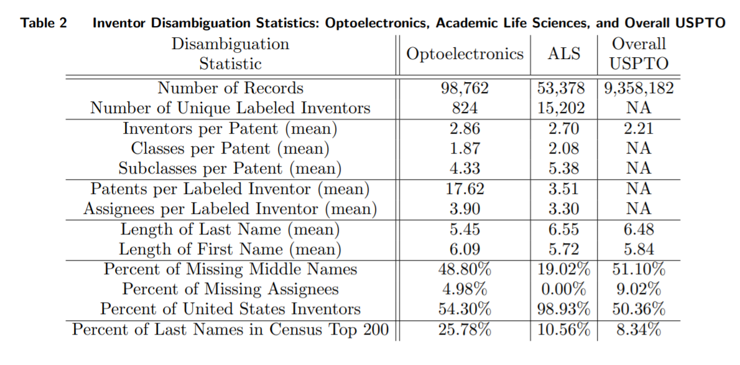
Ventura, Samuel and Nugent, Rebecca and Fuchs, Erica Renee, Seeing the Non-Stars: (Some) Sources of Bias in Past Disambiguation Approaches and a New Public Tool Leveraging Labeled Records (January 27, 2015). Research Policy, Forthcoming. Available at SSRN: https://ssrn.com/abstract=2079330 or http://dx.doi.org/10.2139/ssrn.2079330

Slide 8
